Slide 1
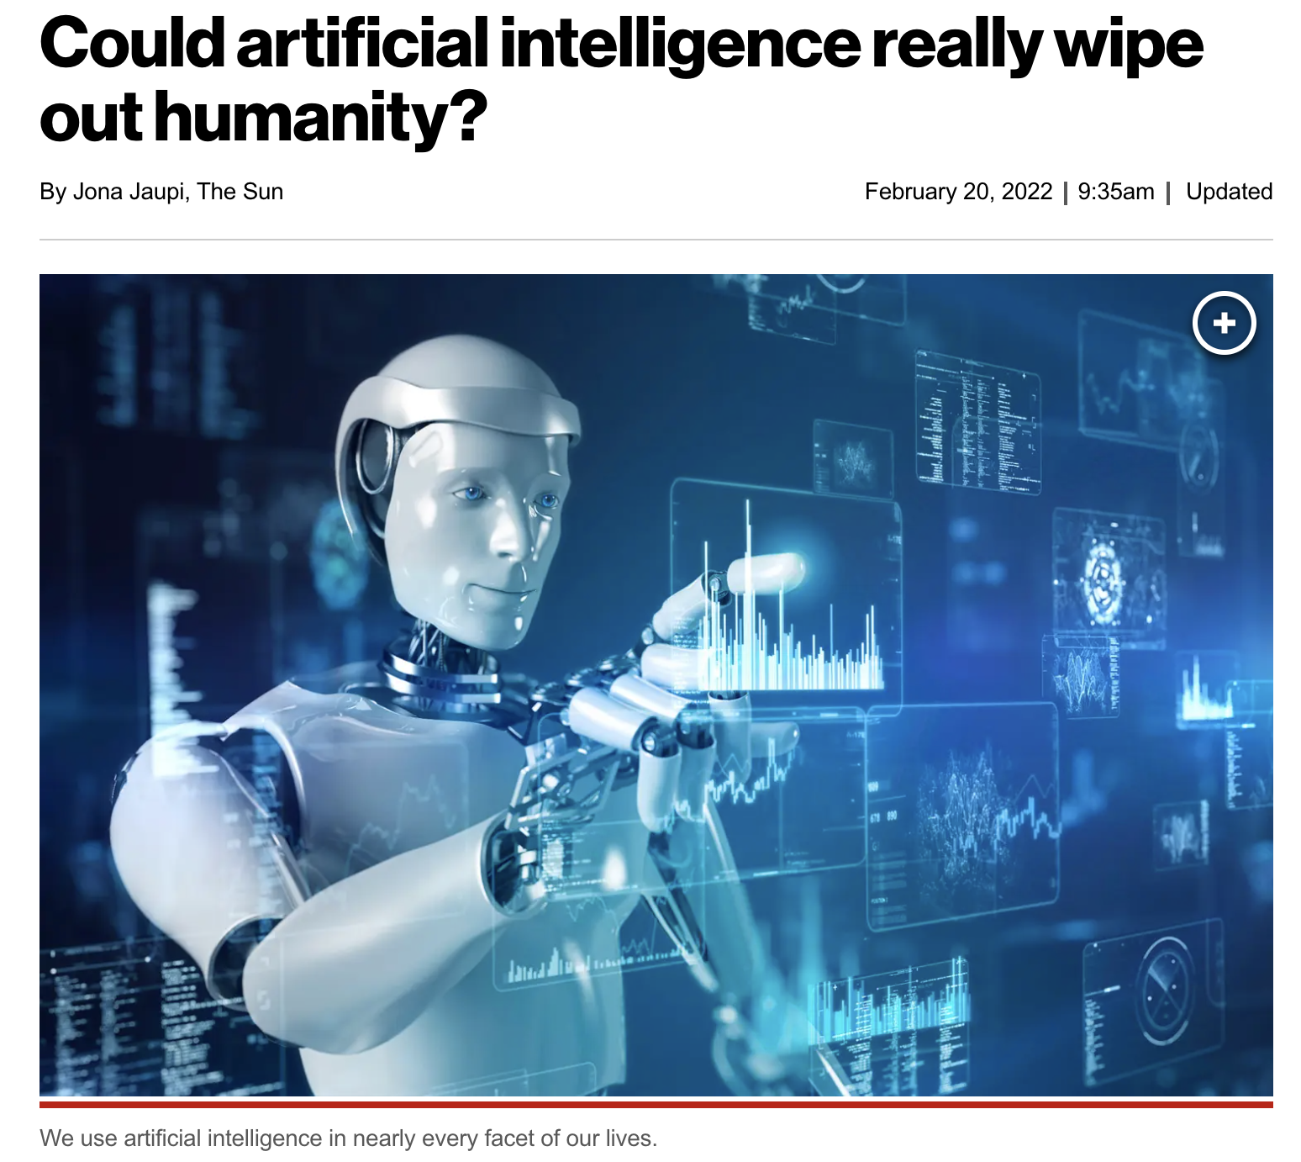
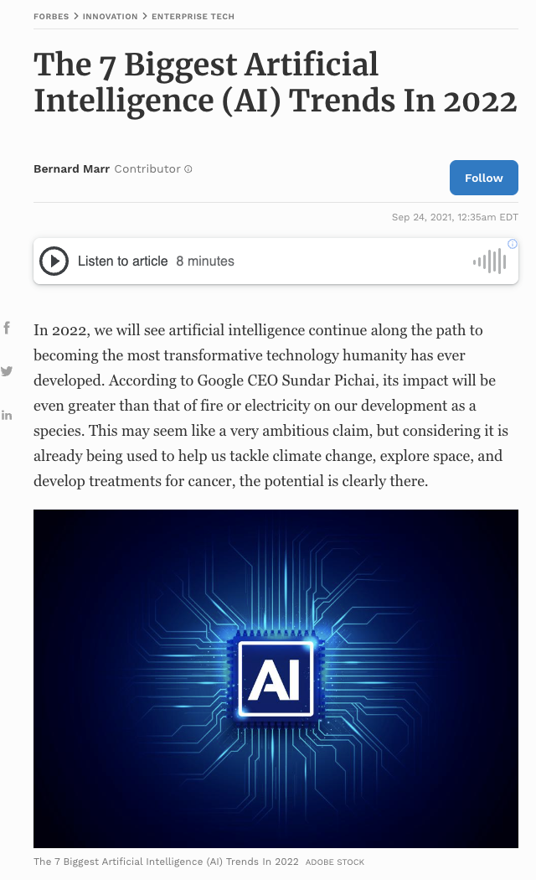
Lecture 01: Course Overview
Objectives:
Course Goals Terminology
The Design Cycle
Generalization and Risk
Understanding vs. Recognition
Feature Confusability
Common Mistakes
Three Rules of Machine Learning
Resources:
Course Syllabus
Textbook (Sections 1.1 – 1.3)
TED Talks

Slide 2

Terminology
Dispel The Hype: Artificial Intelligence (AI) is not taking over the world anytime soon. Machine learning (ML) systems are simply good at memorizing patterns and emulating functional mappings.
Technology: Introduce you to the tools and concepts being used in modern machine learning research and technology development.
Theoretical Underpinnings: Develop a mathematically rigorous understanding of ML algorithms.
Connections: Connect a wide range of topics such as statistics, experimental design and signal processing via their foundations in mathematics, statistics and machine learning.

Slide 3
Terminology
Pattern Recognition: “the act of taking raw data and taking an action based on the category of the pattern.”
Common Applications: speech and image recognition, machine translation, fingerprint identification (biometrics) and just about everything else including financial modeling, autonomous vehicles and even drug discovery.
Related Terminology:
Machine Learning: “It gives computers the ability to learn without being explicitly programmed.” (Arthur Samuel, 1959)
The ability of a machine to improve its performance based on previous results.
Machine Understanding: acting on the intentions of the user generating the data.
Big Data: “Big data is like teenage sex: everyone talks about it, nobody really knows how to do it, everyone thinks everyone else is doing it, so everyone claims they are doing it.” (Dan Ariely, 2013)
Statistics: There is a strong connection between modern engineering, statistics and machine learning. Many of the same tools are used but known by different names.

Slide 4
The Classic Machine Learning Paradigm
Key issues:
Is the data representative of the problem?
Do the features capture meaningful differences between patterns?
How do we find the best model?
How do we estimate the parameters of the model?
How do we evaluate performance?
Collect Data
Evaluate Classifier
Select Features
Train Classifier
Choose Model
Other considerations:
The answers are often application specific and data dependent.
Customers/users don’t often completely understand their requirements.
Data collection is often an on-going process that drives the technology.

Slide 5



The Importance of Driving Research Using Big Data
Bob Mercer, IBM Speech Research (1985):
“There is no data like more data.”
Dan Ariely, Duke University (2013):
“Big Data is like teenage sex: everyone talks about it, nobody really knows how to do it, everyone thinks everyone else is doing it, so everyone claims they are doing it.”
Douglas Merrill, Zestfinance.com (2013):
“Given enough data, everything is statistically significant.”

Slide 6
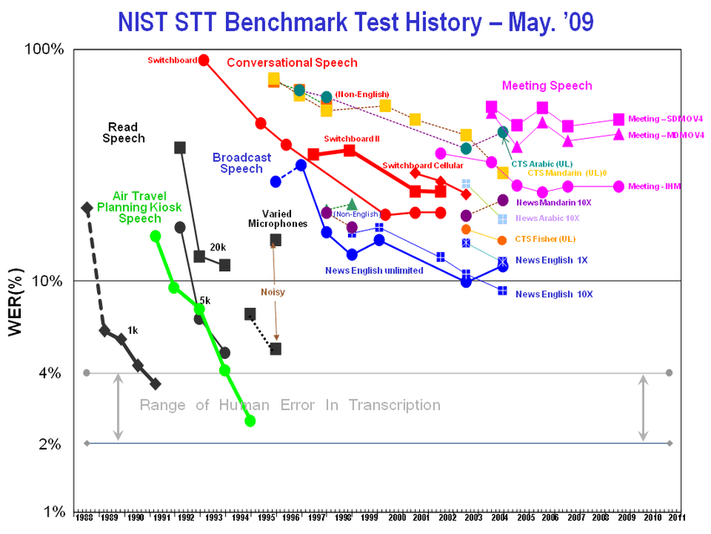
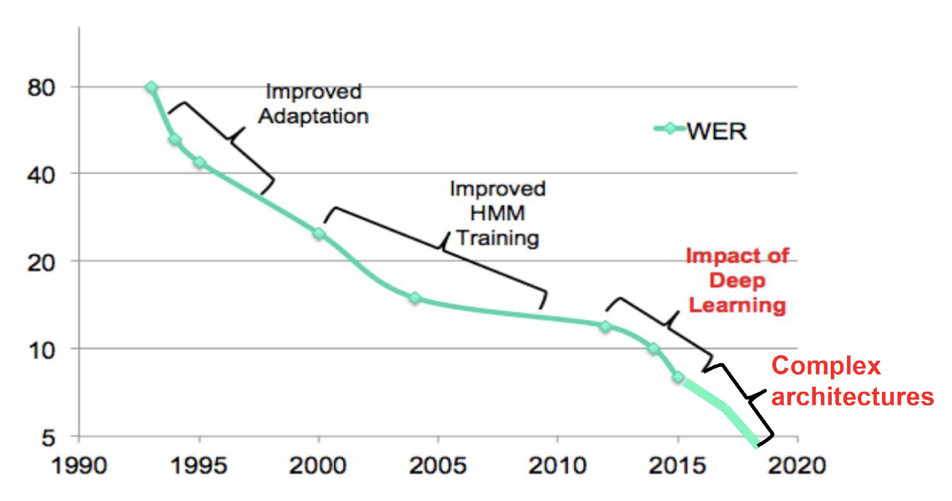
Speech Recognition Did Not Happen Overnight
Services like Siri and Alexa were overnight successes that were 50 years in the making…
The common evaluation paradigm in speech recognition dates back to the 1980’s when the first industry-wide speech recognition evaluation results were published.
The Linguistic Data Consortium was established by DoD in 1992 to provide human language technology data and resources to the community to drive research and standardize evaluation.

Slide 7
Generalization And Risk
How much trust can we place in isolated data points?
What is the optimal decision surface?
Suppose you now receive two more data points?
The optimal decision surface is still a line, so this new data is consistent with our current beliefs.
Next, you receive two more data points. What is the optimal decision surface?
The optimal decision surface changes abruptly with these two new data points. Is this a good thing?
In this course, we will study techniques that can easily drive the error rate to zero on the training data – referred to as overtraining. Is this the best classifier for previously unseen data?
We will see that the collection of data that accurately characterizes the problem, is critical: “There is no data like more data.”
Some applications, particularly bioengineering, only have limited data. Some events, such as natural disasters (e.g. tsunamis), do not have more than a few data points.
For such applications, we must use model-based approaches (e.g. differential equations).
Can we integrate prior knowledge about the likelihood of each class, application constraints (e.g., N-gram frequencies, the grammar of a language or the physics of the real world) to make better decisions when faced with limited amounts of data?

Slide 8



Recognition or Understanding?
Which of these images are most scenic?
Half of the battle in building a machine learning system is understanding the requirements and developing data (e.g., annotated data) to support those requirements. We often iterate several times to get things ‘right’.
How can we develop a system to automatically determine scenic beauty? (Hint: feature combination)
Solutions to such problems require good feature extraction, good decision theory and good user interface engineering (e.g., Alexa).

Slide 9
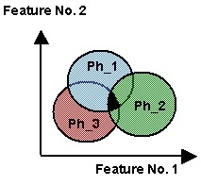
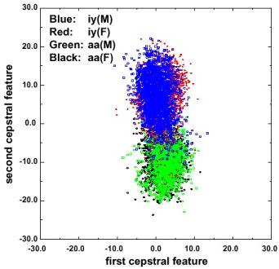
Traditional Model-Based Features Are Confusable
Regions of overlap represent the classification error
Error rates can be computed with knowledge of the joint probability distributions (see probability of error in transmission).
Context is used to reduce overlap.
In real problems, features are confusable and represent actual variation in the data.
The traditional role of the signal processing engineer has been to develop better features (e.g., “invariants”).

Slide 10
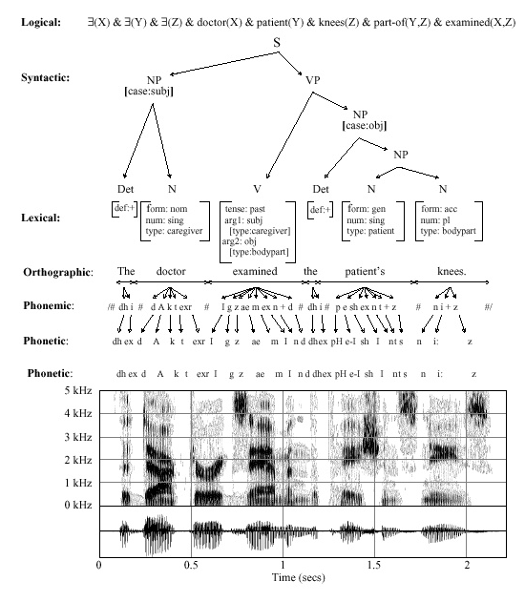
Classical Pattern Recognition: Problem Decomposition
Decision
Post-Processing
End-to-End Deep Learning
Classification
Feature Extraction
Segmentation
Sensing
Input

Slide 11
Common Mistakes Made By Novices
I got 100% accuracy on...
Almost any algorithm works some of the time, but few real-world problems have ever been completely solved.
Training on the evaluation data is forbidden.
Once you use evaluation data, you should discard it.
My algorithm is better because...
Statistical significance and experimental design play a big role in determining the validity of a result.
There is always some probability a random choice of an algorithm will produce a better result.
Hence, in this course, we will also learn how to evaluate algorithms and quite a bit about experimental design.

Slide 12
Summary
Three fundamental rules of machine learning:
There is no data like more data.
Are your results statistically significant?
When you compare two algorithms, you must compare them on equal footing (e.g., same data, number of parameters, compute time, latency).
Pattern recognition vs. machine learning vs. machine understanding vs. statistics: significant overlap between these fields.
We will focus more on decision theory and less on feature extraction.
This course emphasizes statistical and data-driven methods for optimizing system design and parameter values.

